Slide 1
NBA Title Prediction data streaming
Team members:
Bayarbayasgalan Jagdal
Htin Shar Kyaw
Sreytouch Lang
Kyaw Thiha

Slide 2
ABOUT OUR PROJECT
Purpose: NBA Champion prediction
Source: Sport Data Open Data API (https://api.sportsdata.io/v3/nba/scores/json/Standings/2023)
Target Data: Standing data custom year
Technologies we used: Kafka, Spark Streaming, Spark SQL, HBase and Tableau
Why NBA sport data?: Based on our interests and Now is going Playoff time.
Demonstration

Slide 3


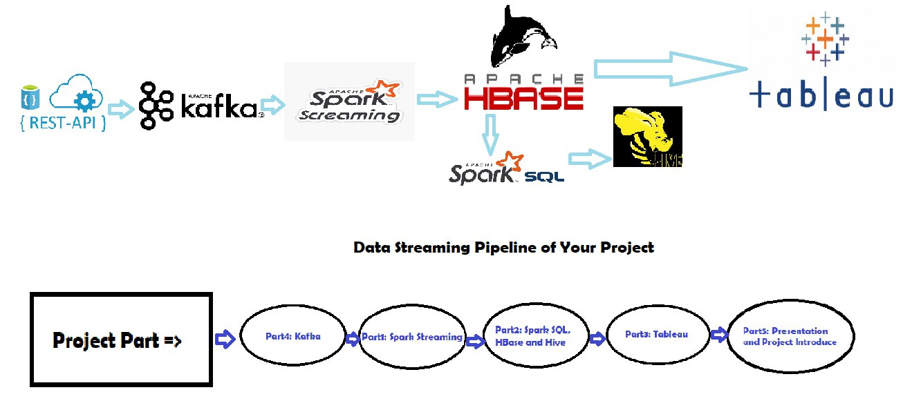

Data streaming pipeline

Slide 4
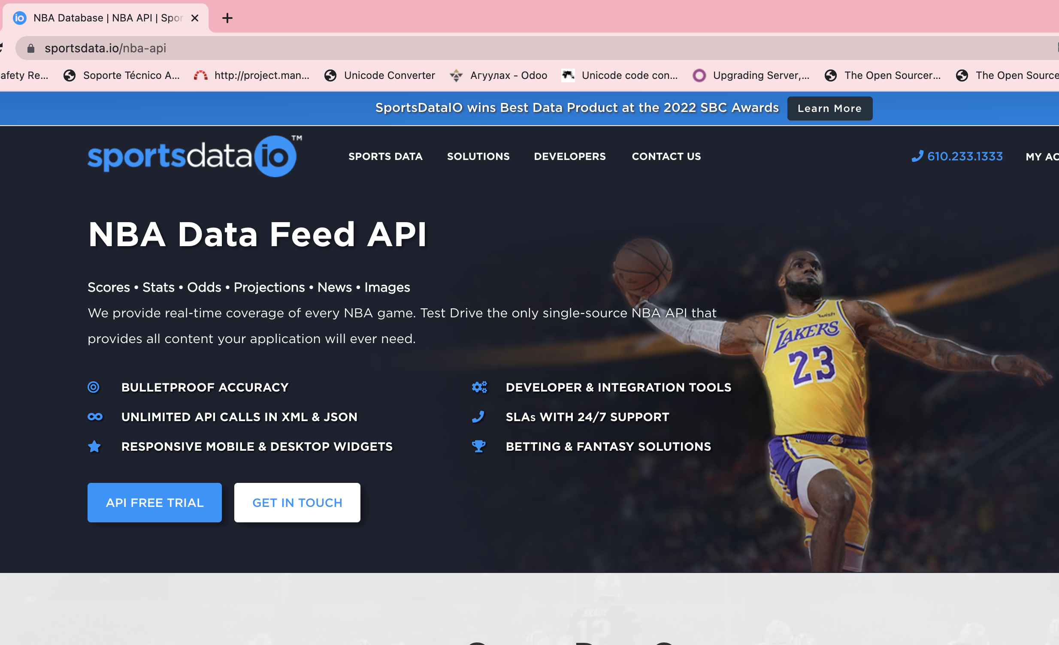
About data source
JSON formatted
Real time and Historical data
Data Hierarchy
Available resources

Slide 5


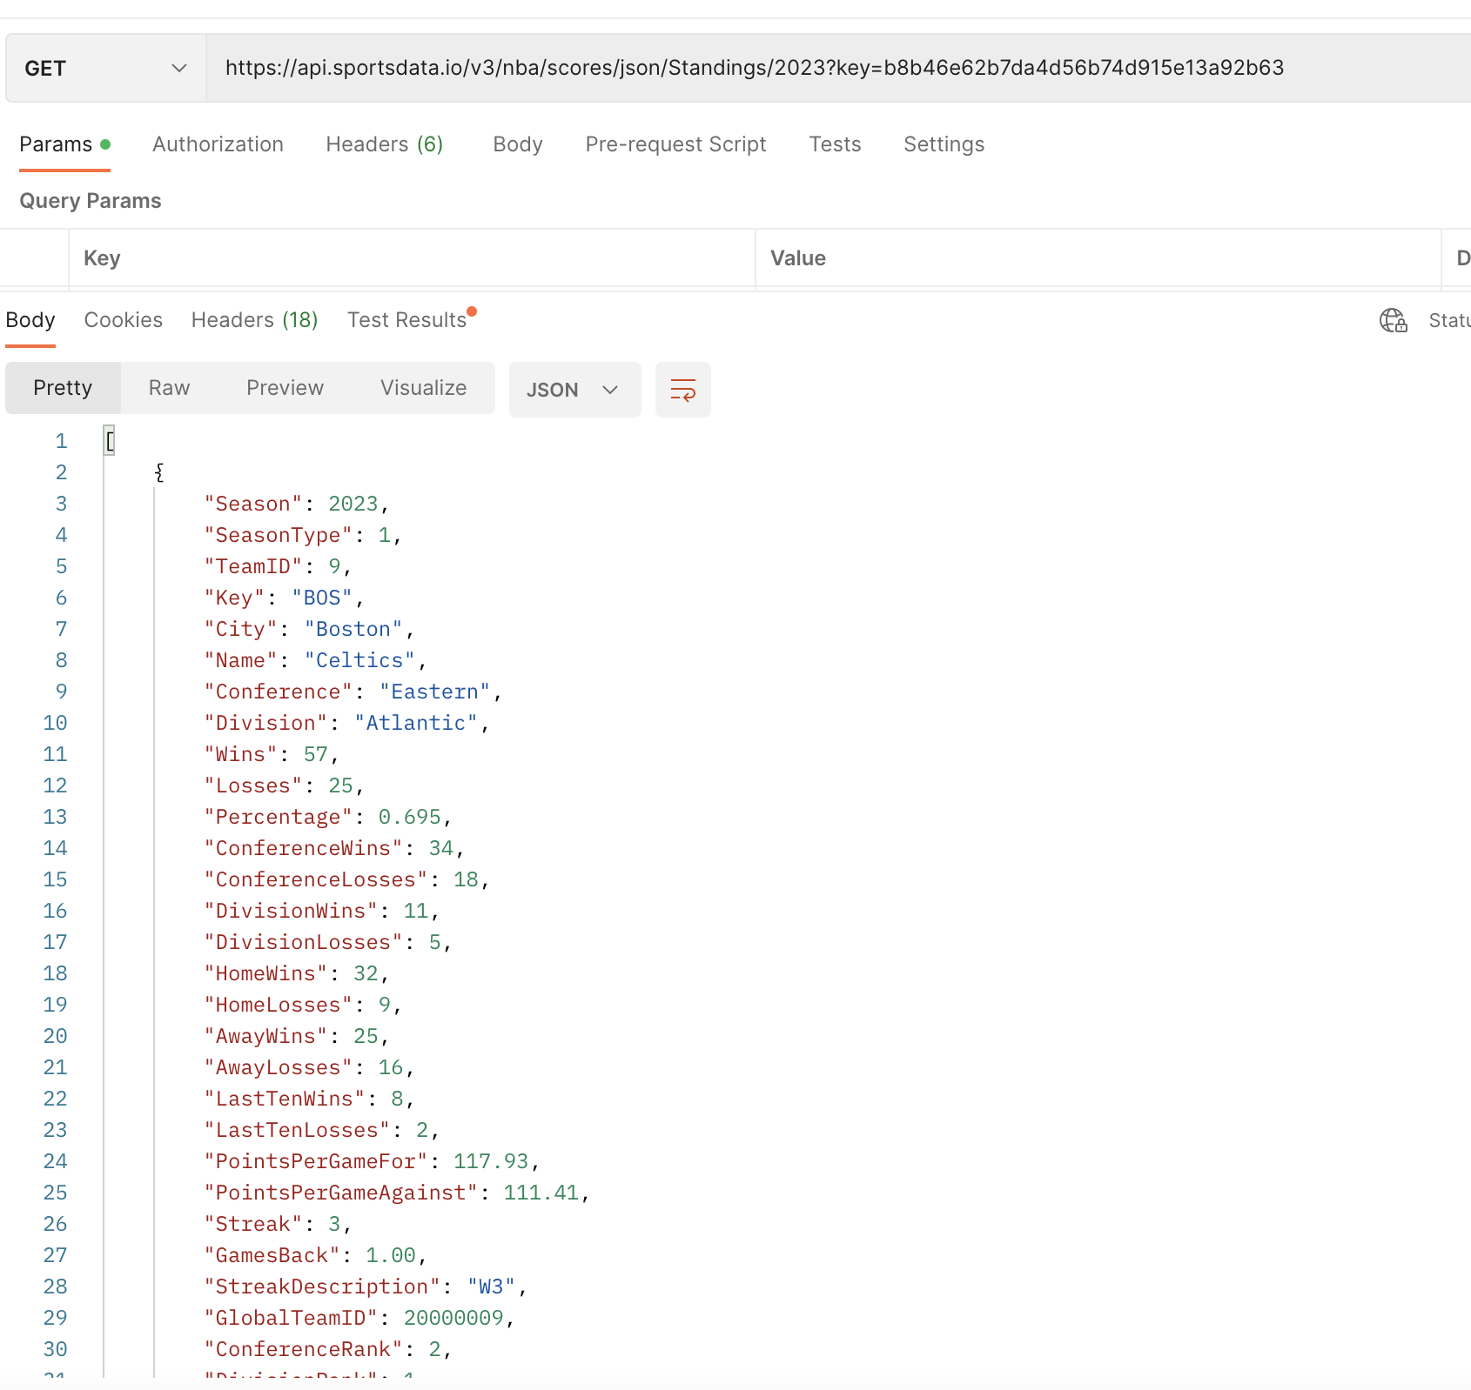

Json data format
Target data: NBA Standing Data
Columns:
TeamID
Season
SeasonType
Key
City
Name
Conference
ConferenceRank
Wins
Losses

Slide 6
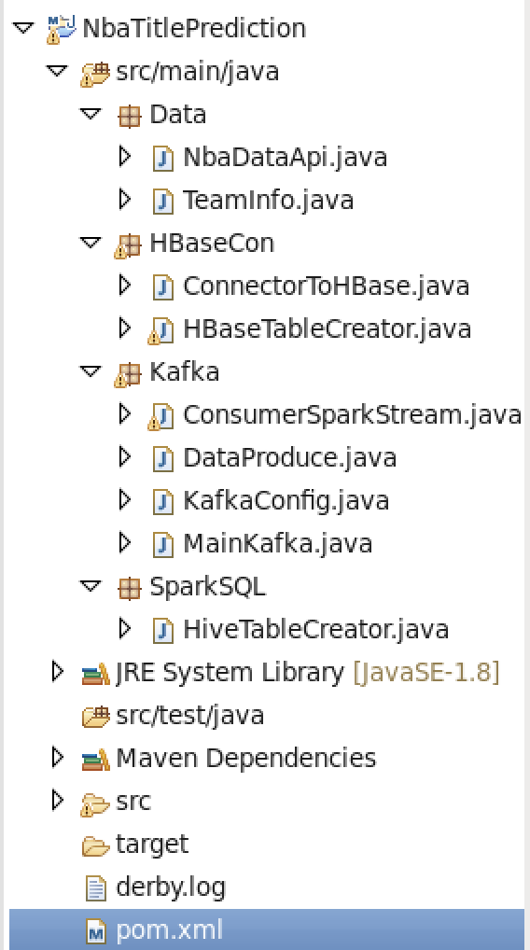
Project Code Desciption
Data
It is our project NBA team API and Team info class
HBaseCon
Create Hbase create and Insert data to Hbase table
Kafka
Read insert data from API after that send to Kafka
And read Kafka Cluster after insert data to Hbase table
SparkSQL
It means read data from Hbase table
After create Hive table after insert data to created Table

Slide 7
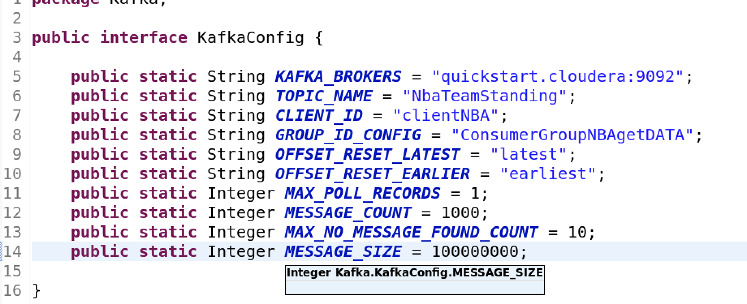
Kafka Config

Slide 8
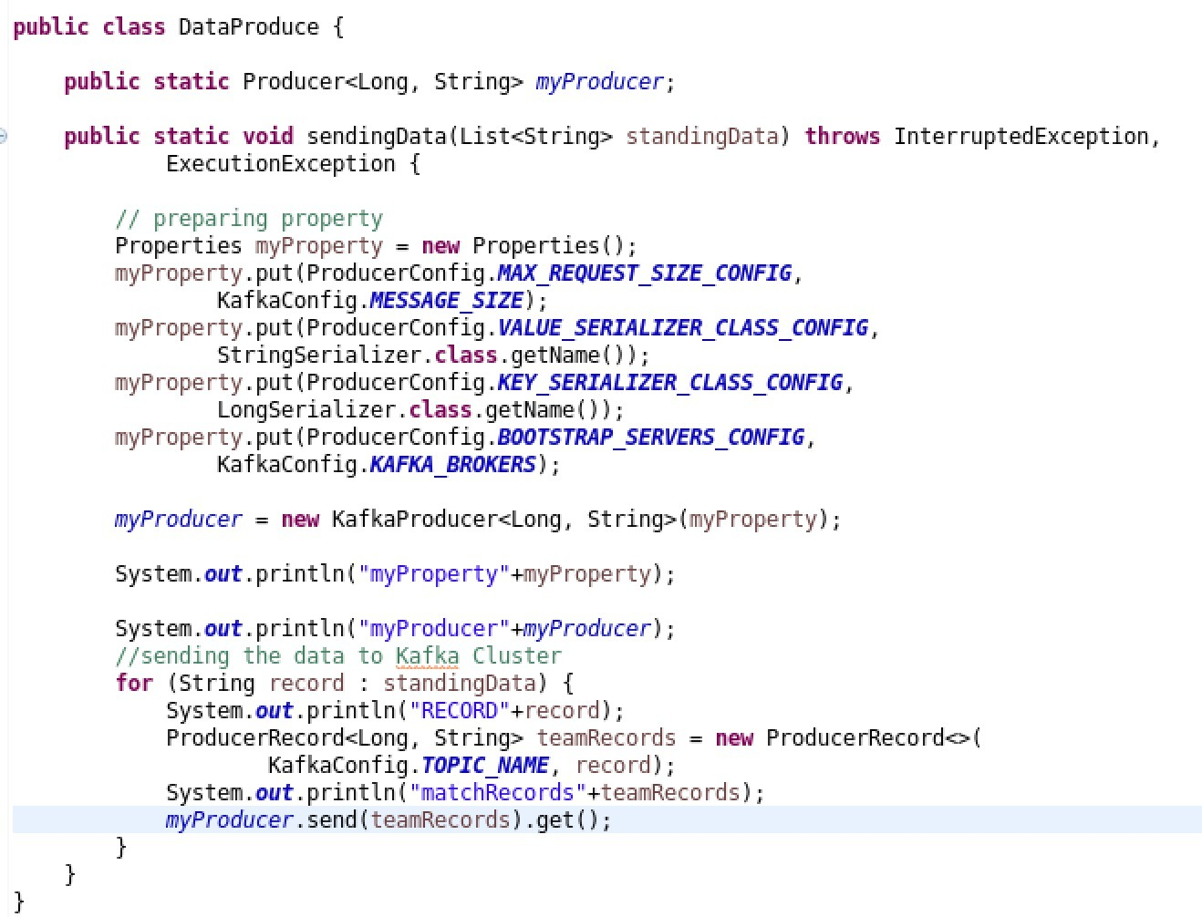
Data publisher
Get list from the Data Collector
Set property from configuration
Sending records into the Kafka Cluster

Slide 9
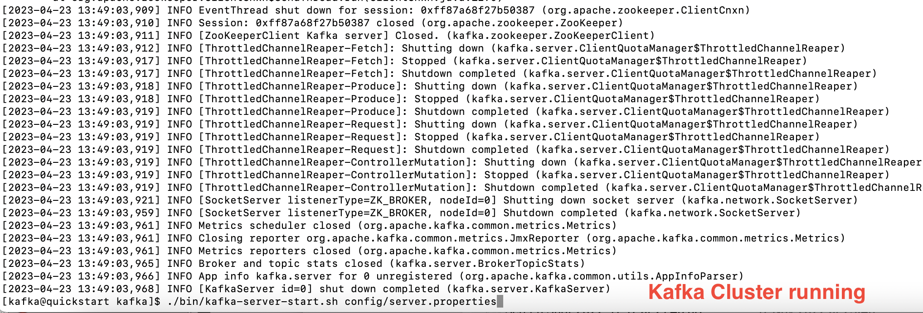
Kafka Cluster Runing

Slide 10
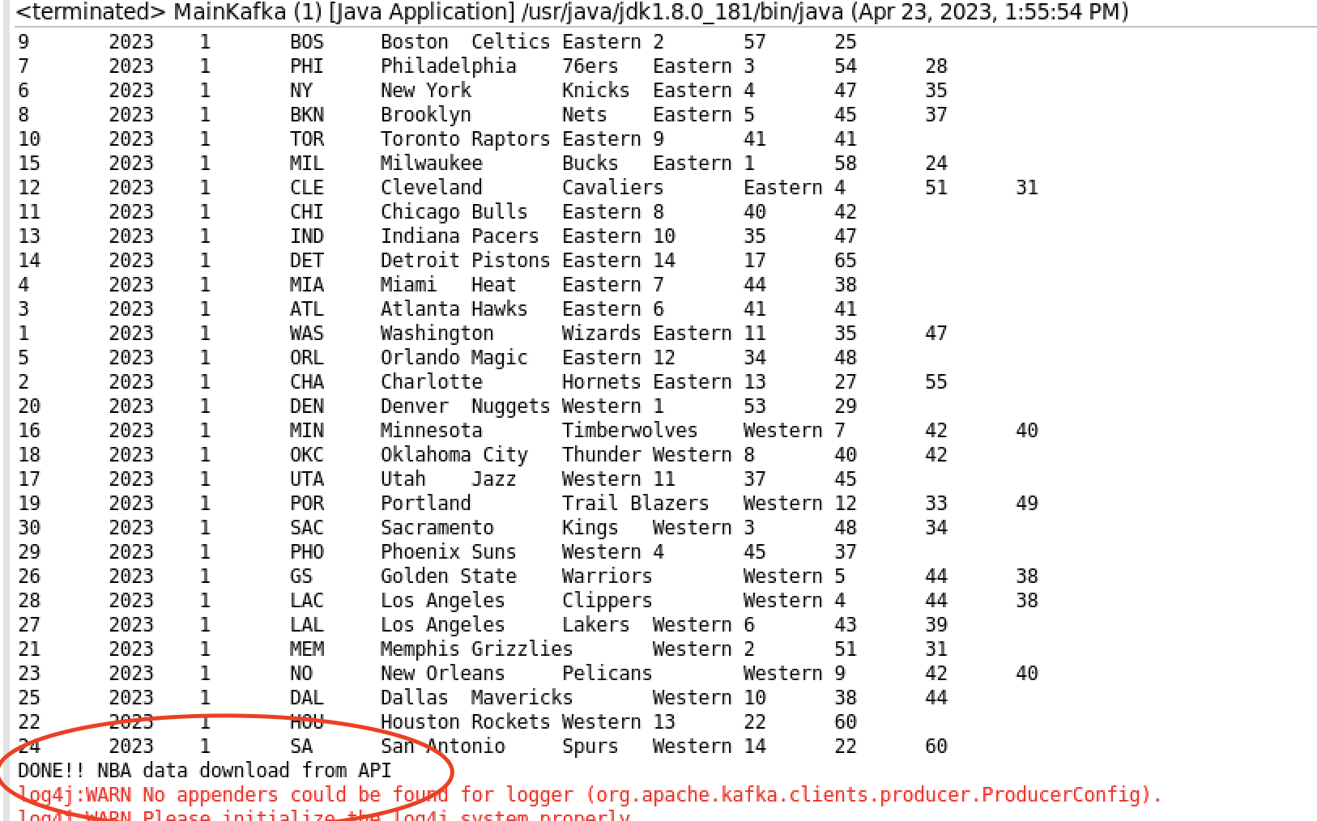
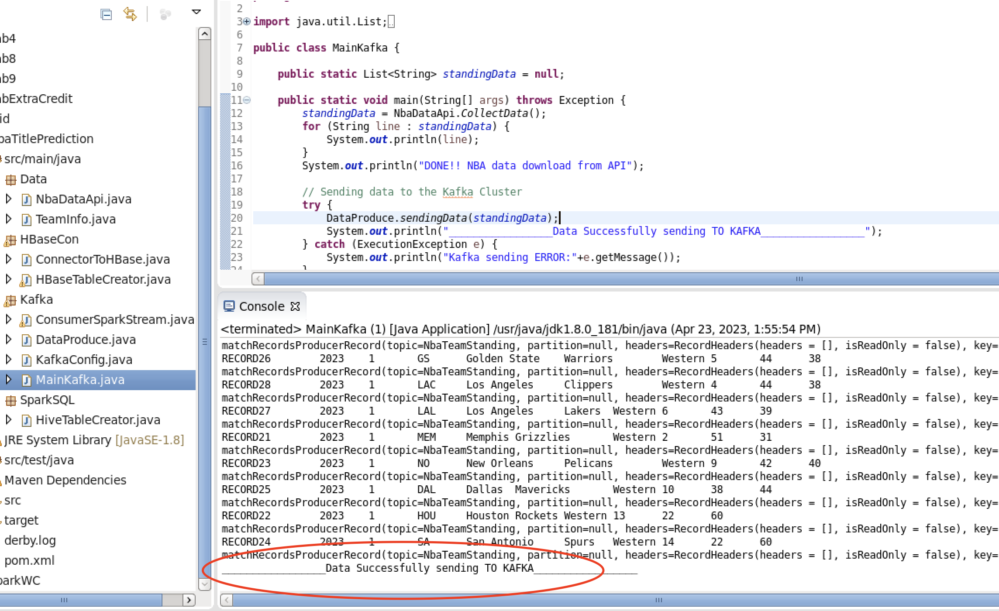
NBA standing data from api and sending that data to Kafka Cluster

Slide 11
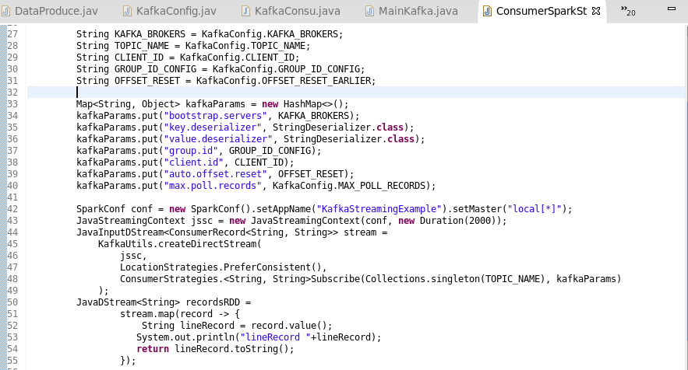
Integration with Kafka and Spark Streaming
https://spark.apache.org/docs/latest/streaming-programming-guide.html
https://spark.apache.org/docs/latest/streaming-kafka-0-10-integration.html

Slide 12
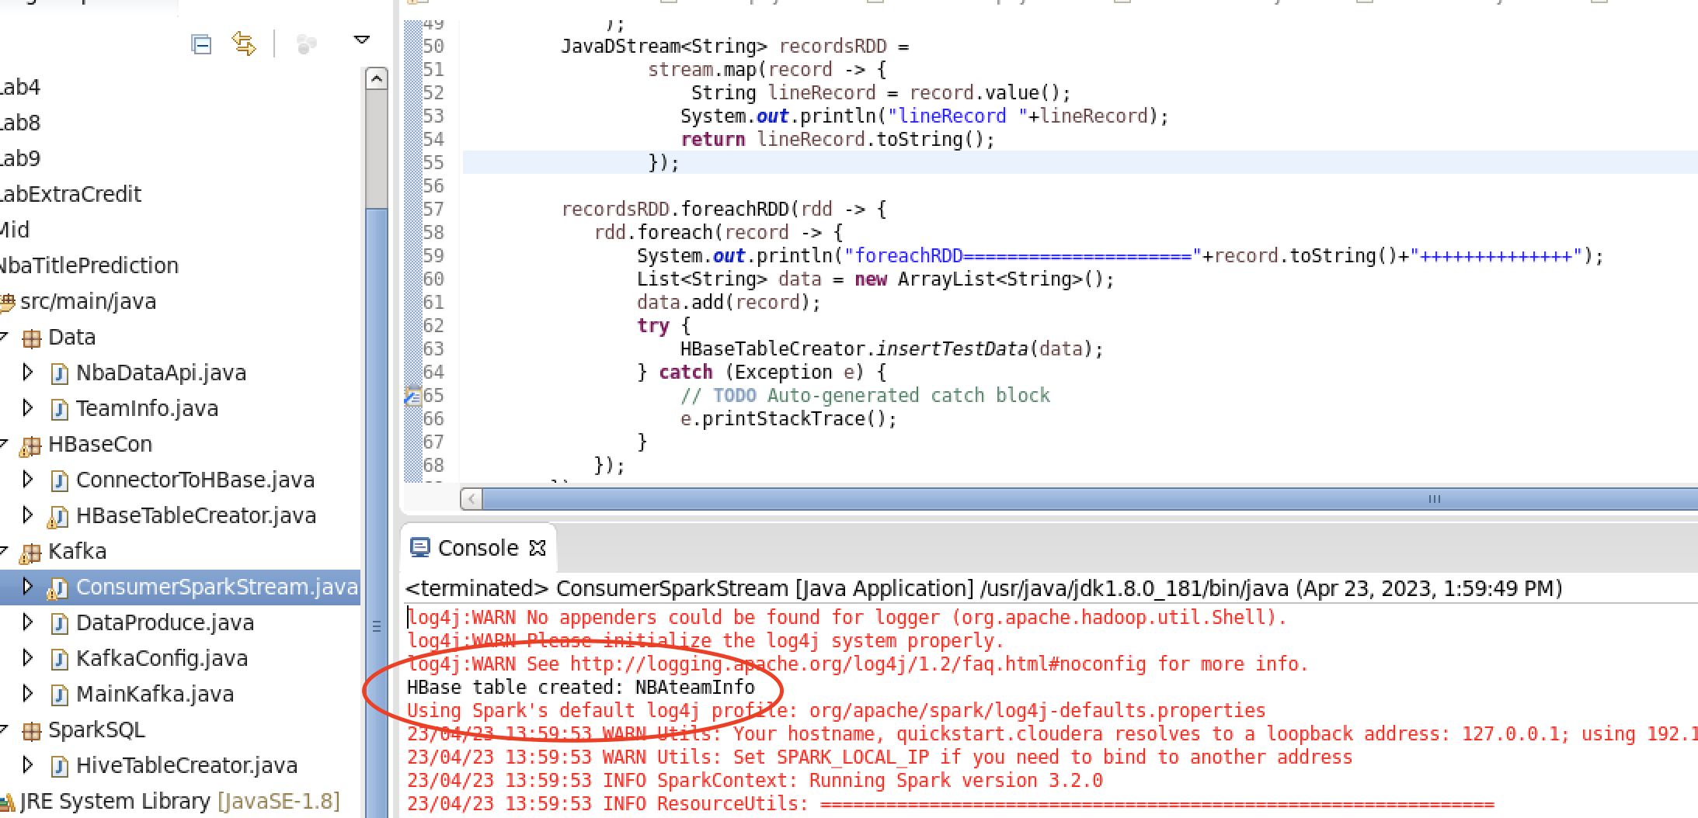
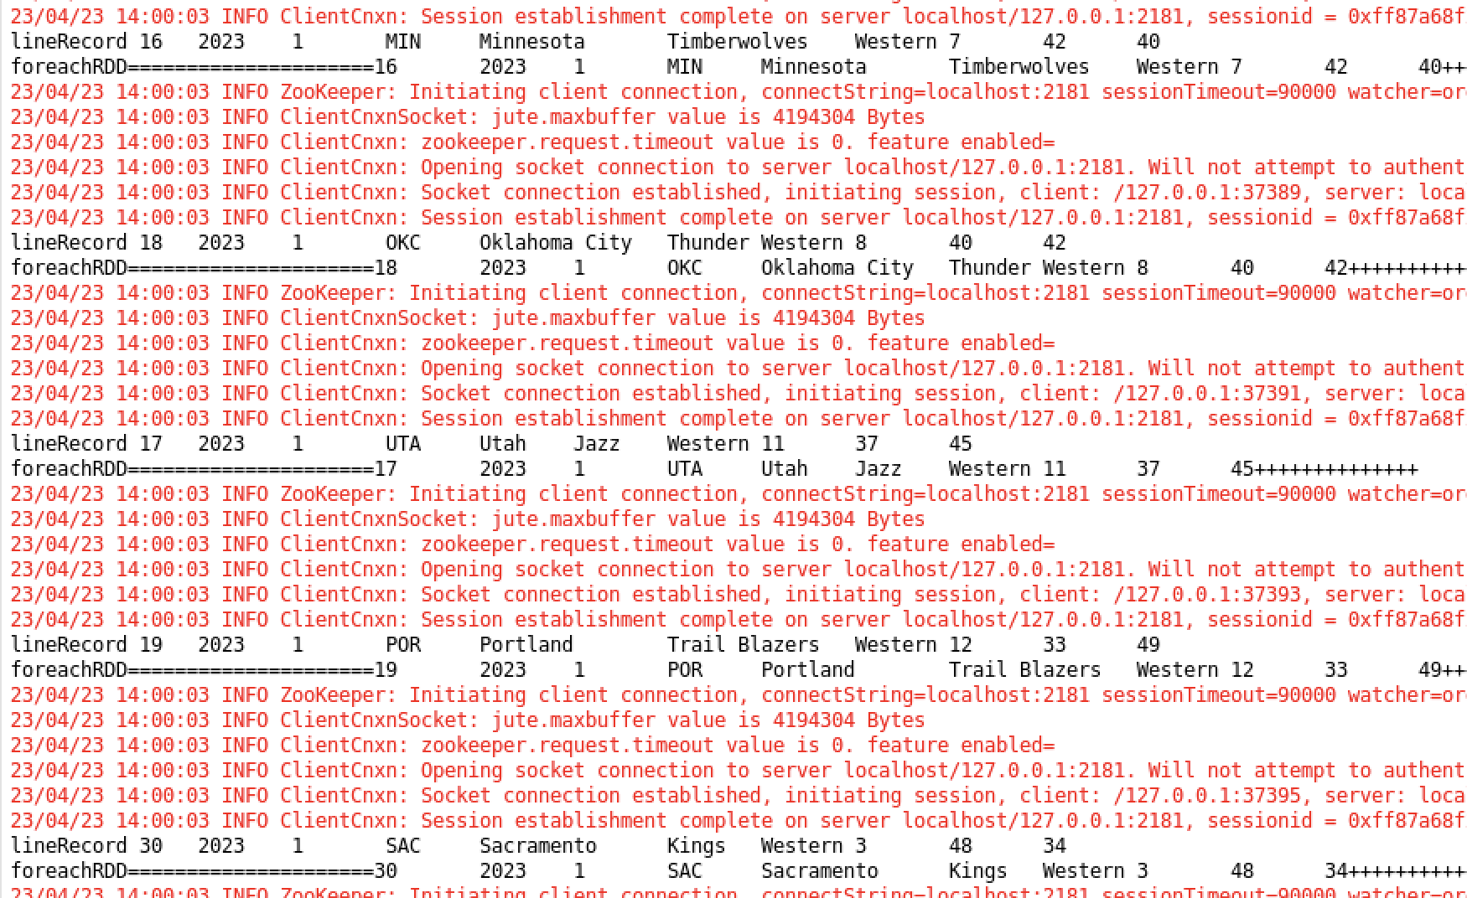
Consuming data and using Spark Stream create HBase table

Slide 13
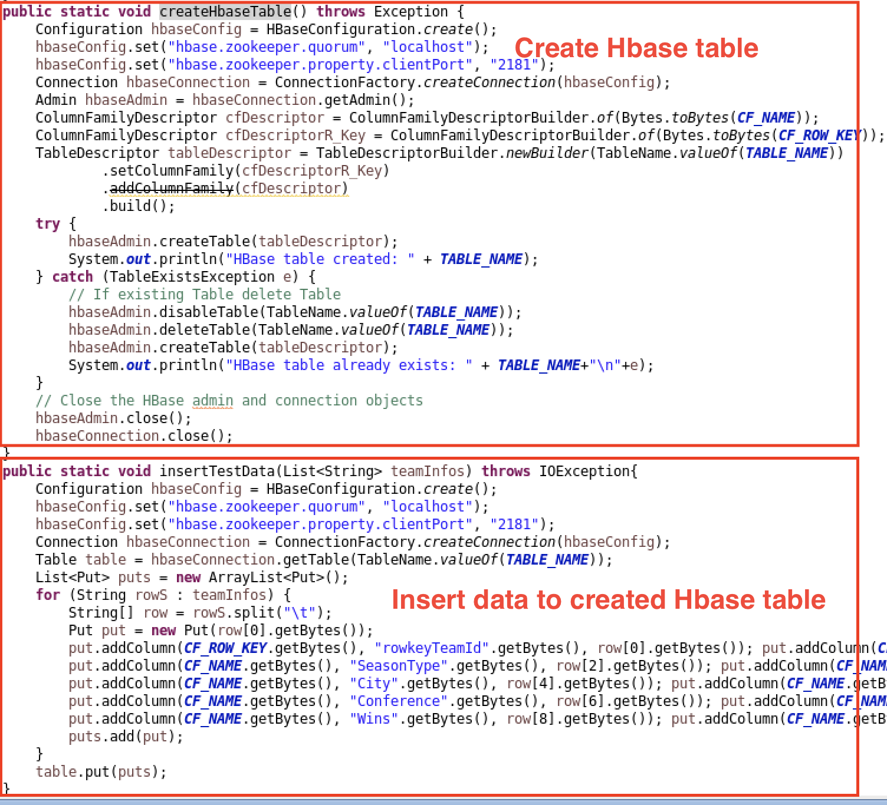
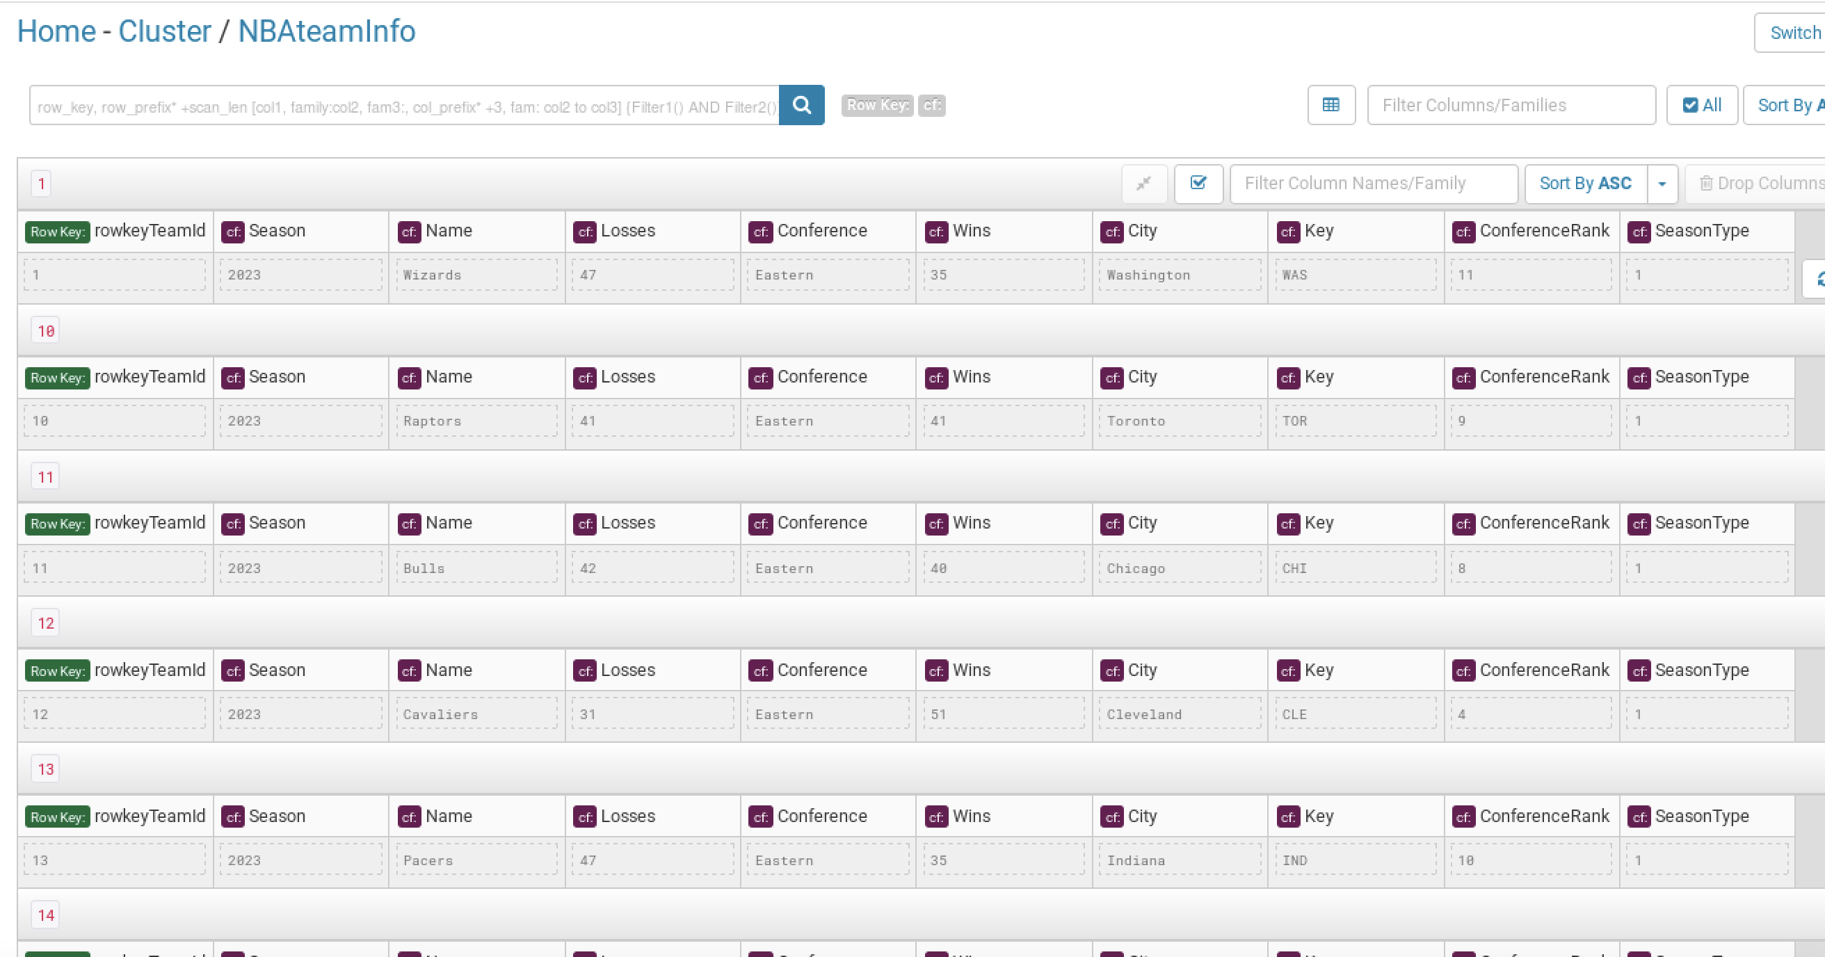
Hbase table Descirption

Slide 14
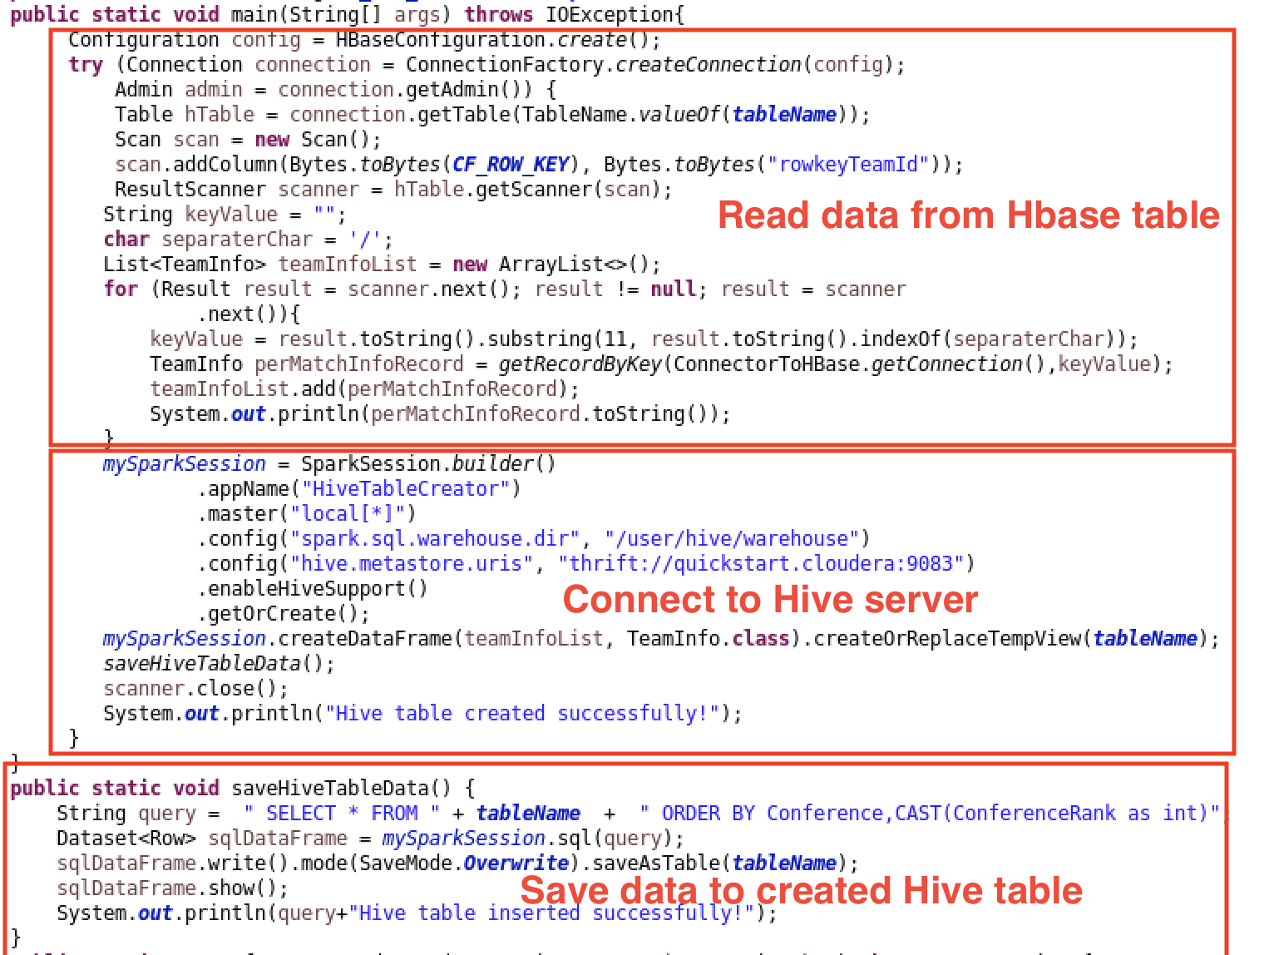
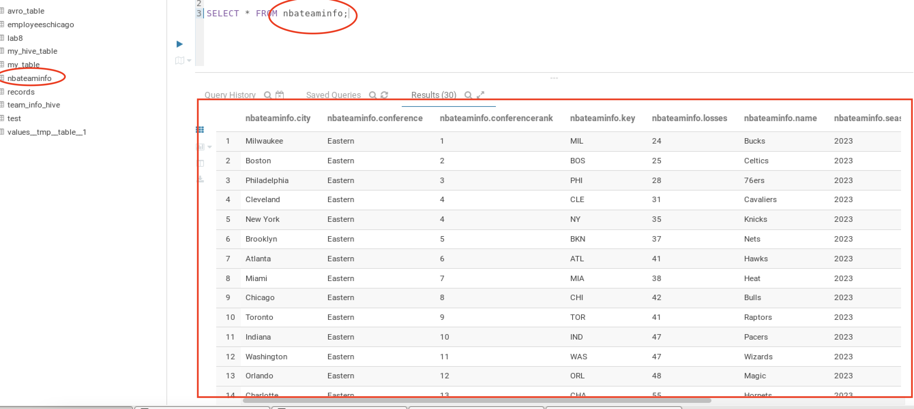
Spark SQL And Hive table

Slide 15
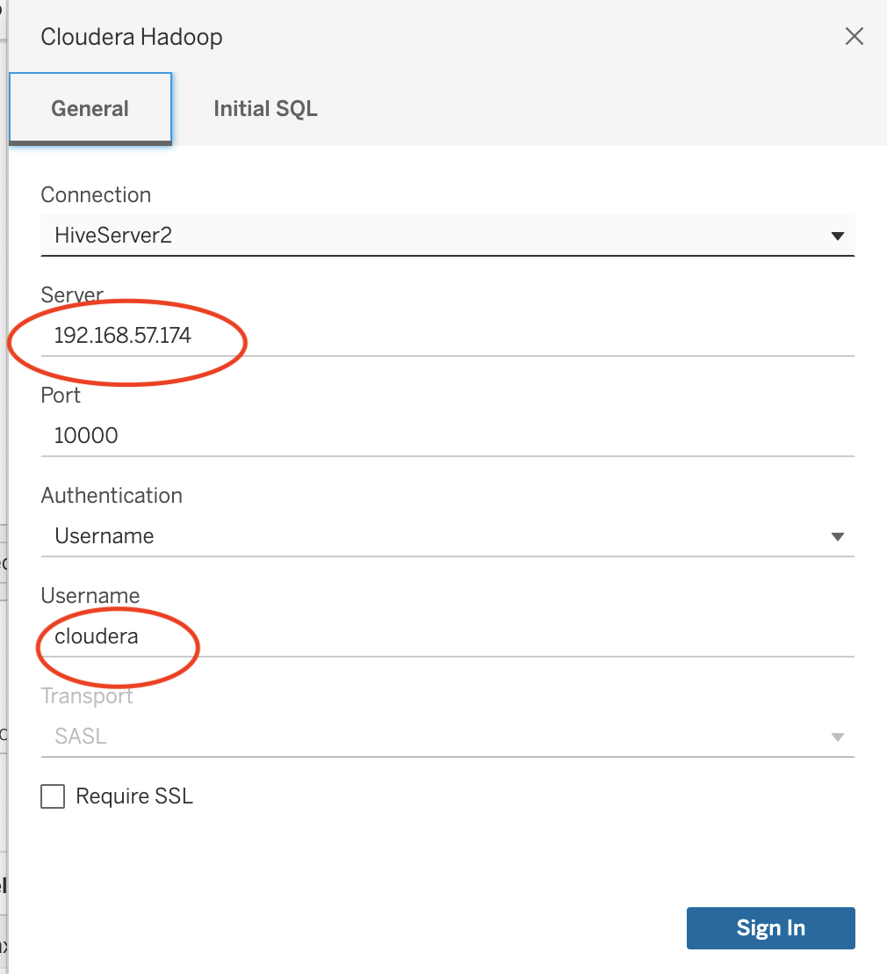
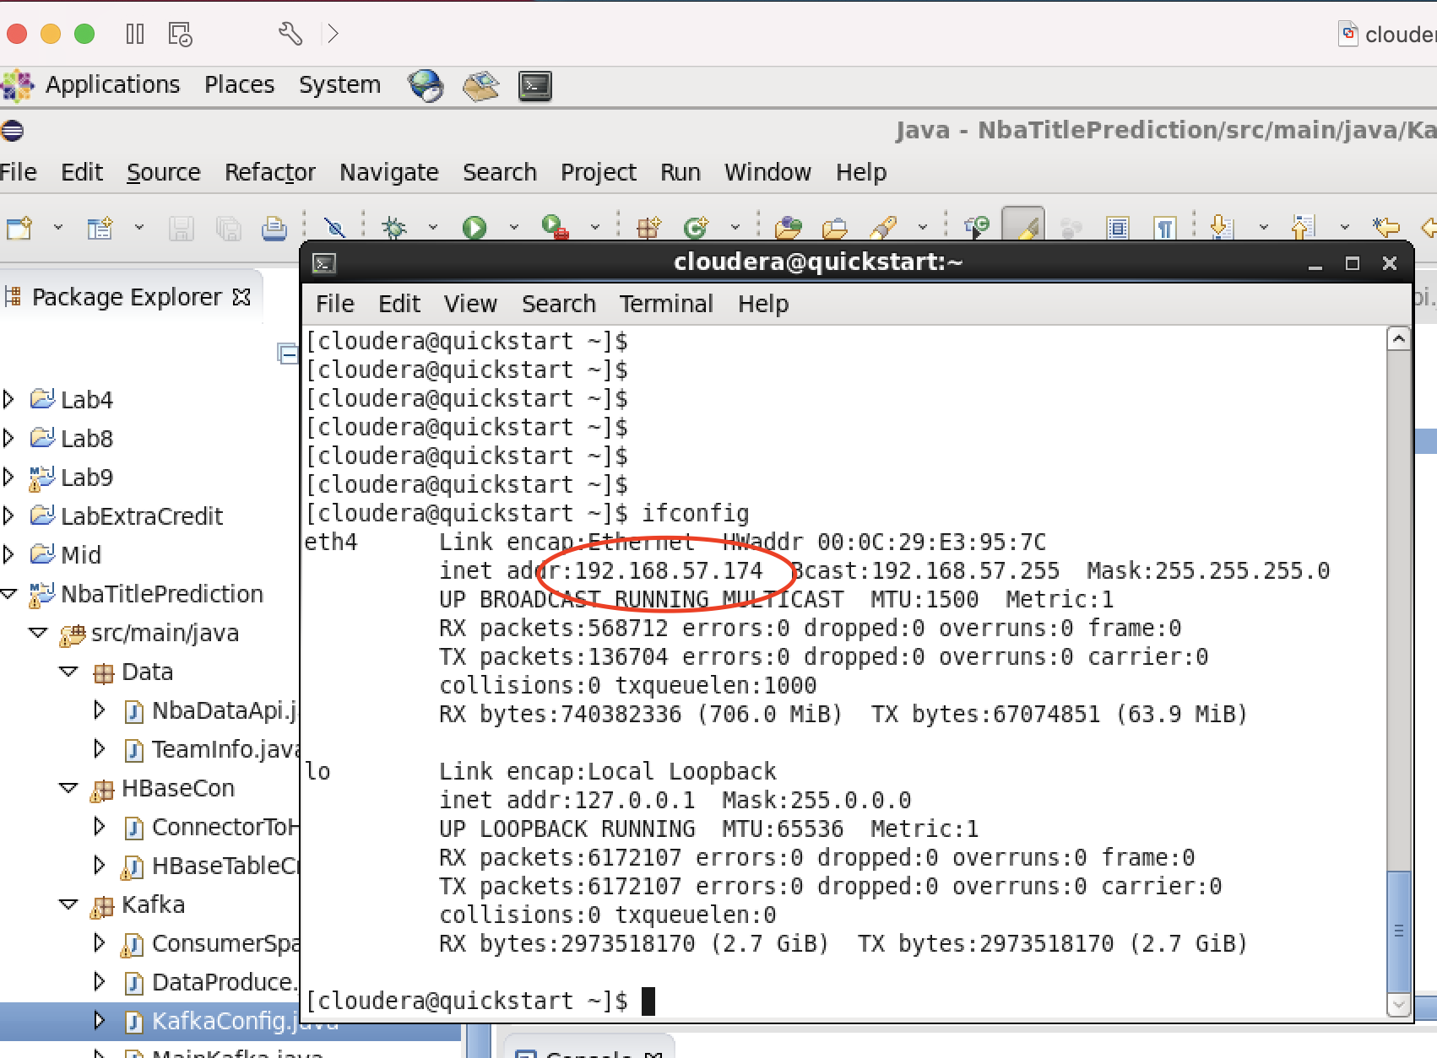
TableAU Connect to Hive

Slide 16
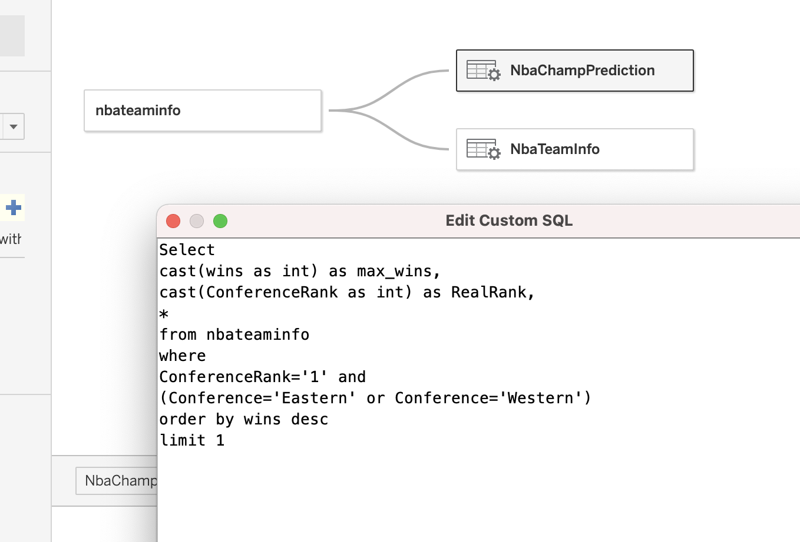
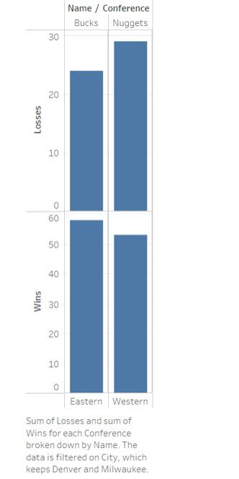
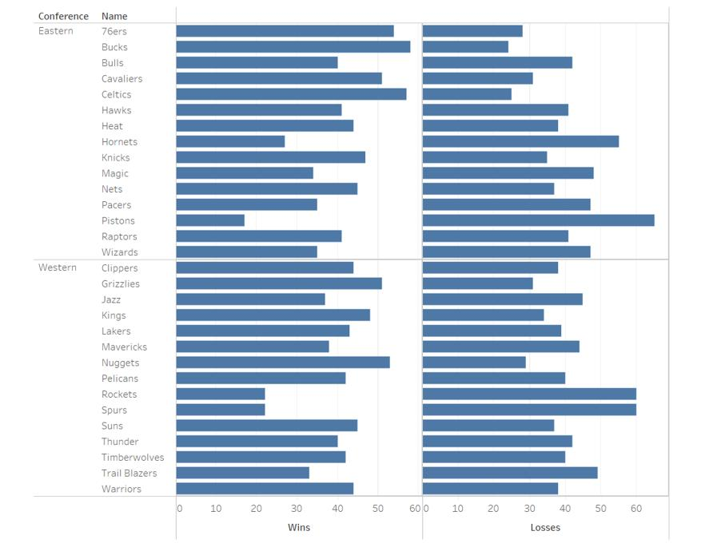
TableAUGraphs and Custom SQL

Slide 17
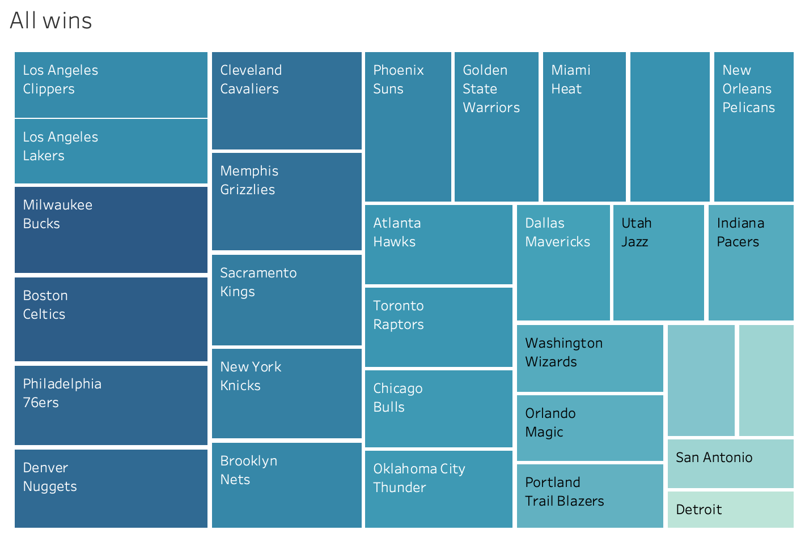
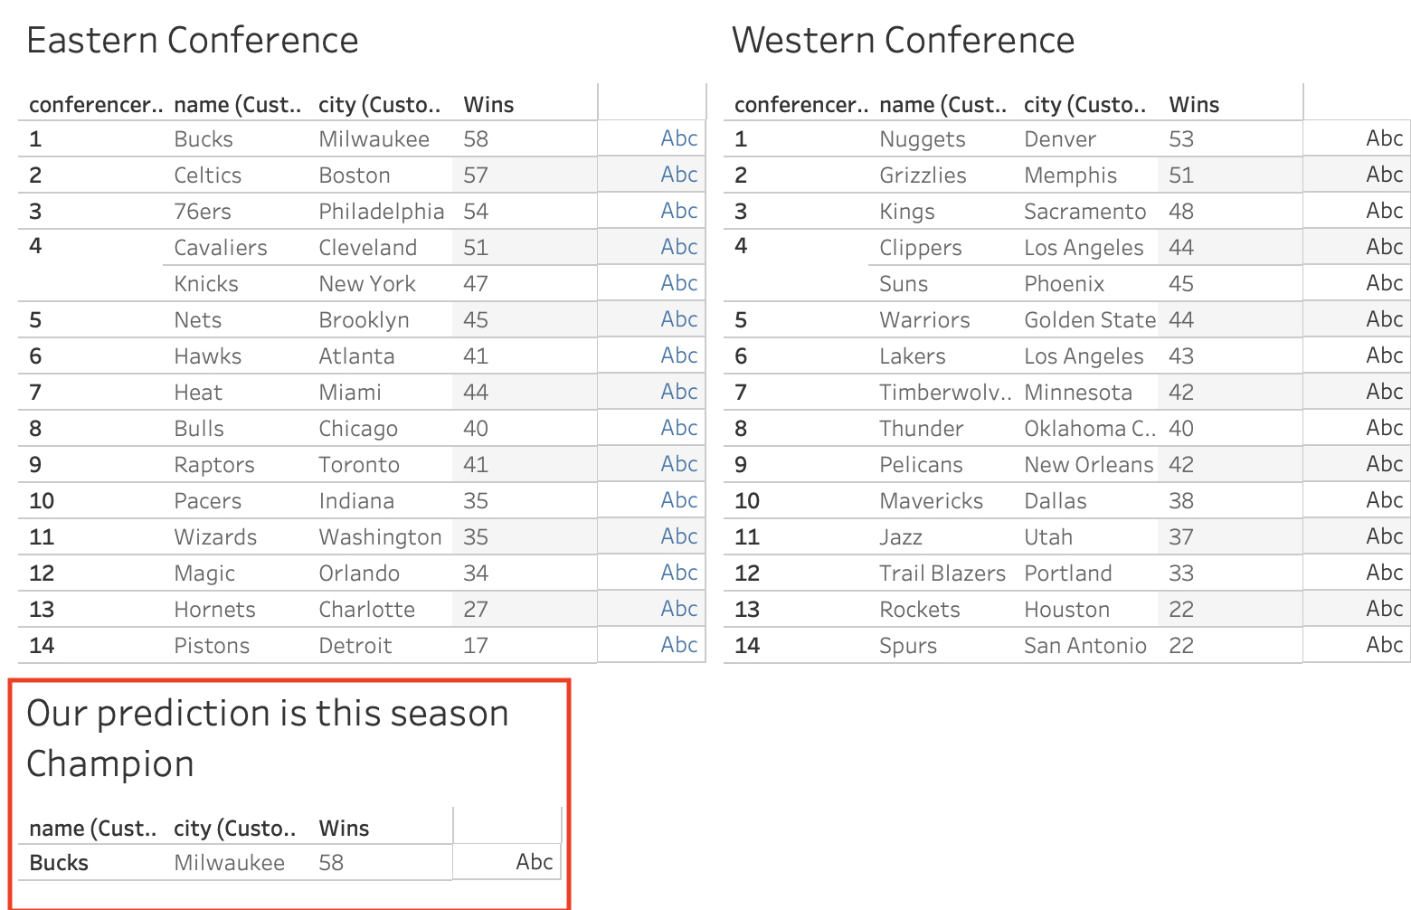
TableAUGraphs

Slide 18

THANK YOU Our team want to say thank you so much for being a professor that support and cares for each individual student.
Thank you for loving your job so much! You are an amazing professor!

